Slide 1


DECODING
ATTRITION
Param Panchal
Vrajkumar Patel
Pravina Prajapati
Dhara Panchal
Prappan Batra
Dhairya Dangi
Group 04

Slide 2

AGENDA
01
INTRODUCTION
02
ABOUT DATA
03
ANALYTICS QUESTION 1
04
ANALYTICS MODELS
05
KEY FINDINGS
06
VISUALIZATIONS FOR QUESTION 2
07
CONCLUSION

Slide 3

INTRODUCTION
In today’s competitive business landscape, retaining skilled and experienced employees is a critical component of organizational success. High attrition rates can have a profound impact on productivity, morale, and ultimately, the bottom line. Understanding the drivers of employee turnover is essential to developing effective strategies for improving retention and sustaining a thriving workplace culture.
“Challenges that an organization has to face due employee attrition are:
Expensive in terms of both money and time to train new employees.
Loss of experienced employees
Impact in productivity
Impact profit”

Slide 4
a
ABOUT DATA
This is a dataset from Kaggle. It contains 35 variables with more than 1400 records.
The predictor variables include “Age”, “Gender”, “Department”, “JobRole”, “MaritalStatus”, “MonthlyIncome”, and many more.
The response variable is “Attrition”, which is a binary variable (YES/NO). It depicts whether an employee stays at the organization or not.

Slide 5
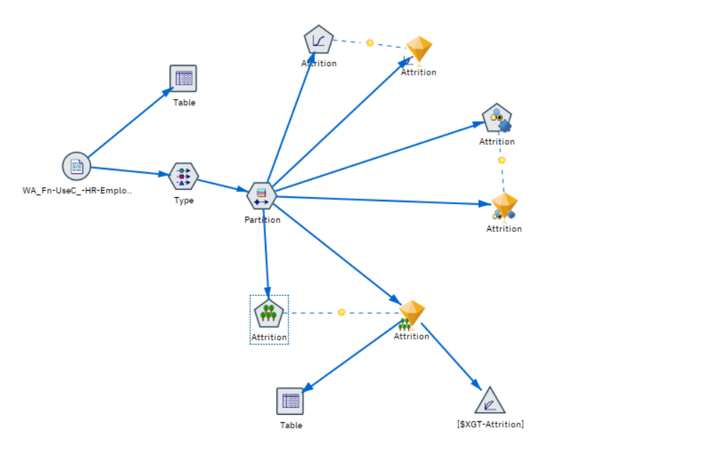
What are the Key Factors driving employee turnover within our organization?

Slide 6
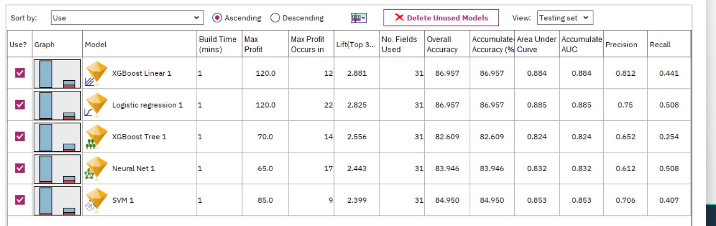
What are the Key Factors driving employee turnover within our organization?

Slide 7
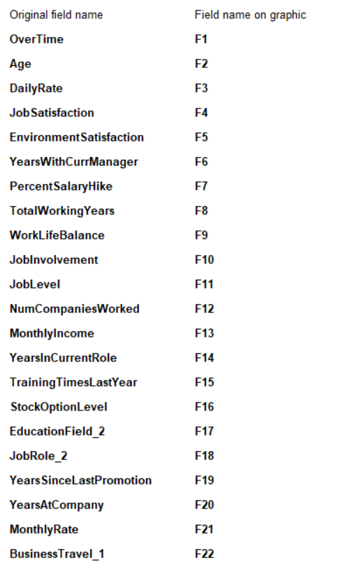
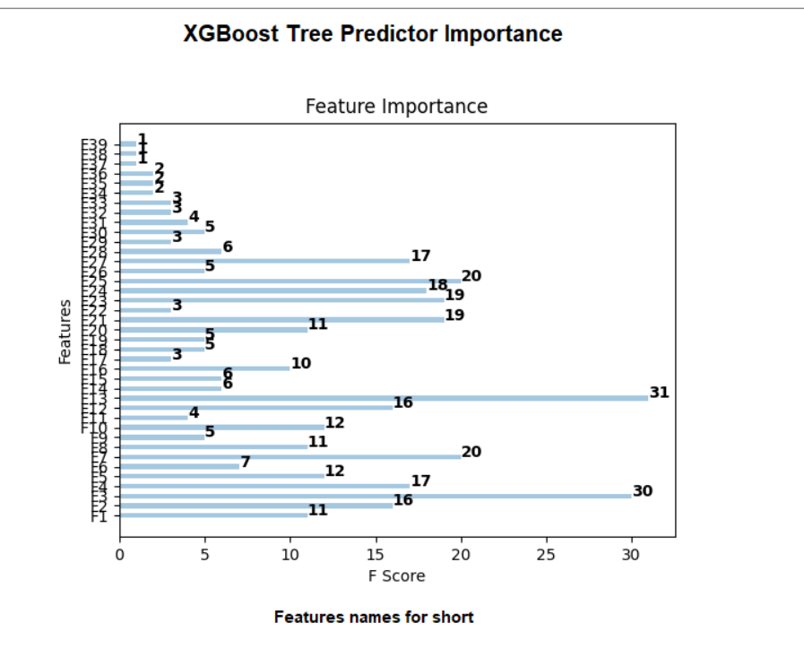
XGBoost Tree

Slide 8
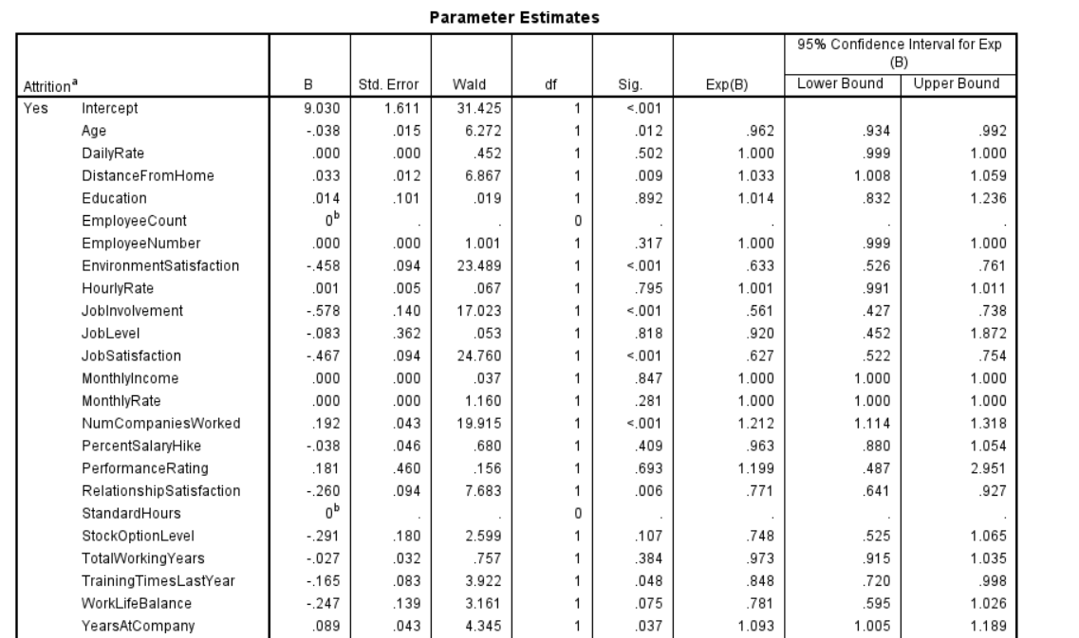
Logistic Regression

Slide 9
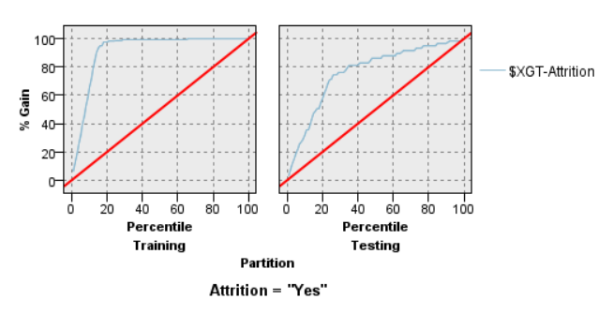
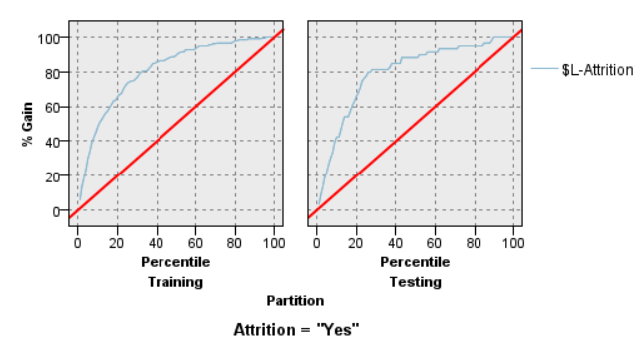
Evaluation Charts
XGBoost Tree
Logistic
Regression

Slide 10
Key Findings
Job Satisfaction, Department, BusinessTravel, Monthly Income, Overtime
[Job Satisfaction]: Job Satisfaction is a very important variable that impacts the attrition rate.
[Department]: This variable also has a high significance level, which suggests that employees of a certain department are more likely to leave than other departments.
[BusinessTravel]: This indicates that employees who travel frequently for business are more likely to leave the company compared to those who do not.
[MonthlyIncome]: From the XGBoost model, we found that monthly income had the highest F-Score amongst all the variables. Employees with lower income are more likely to leave the organization.
[OverTime]: Employees who do not work overtime are less likely to leave the company compared to those who do.

Slide 11
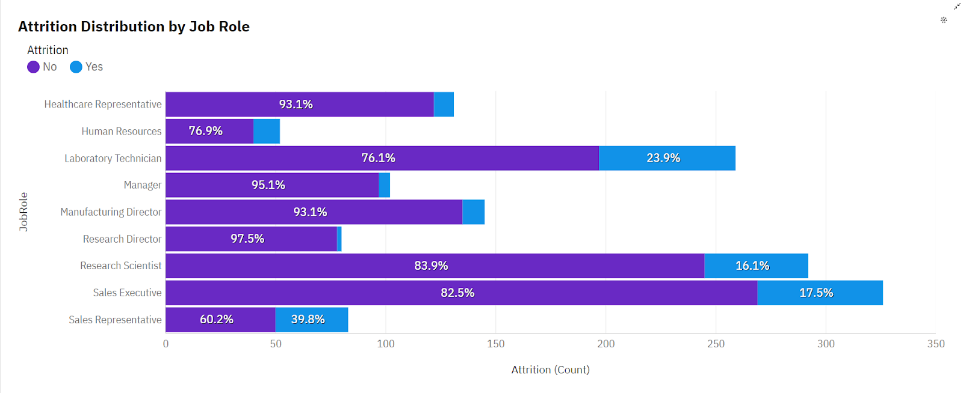
Variance in attrition rate across different factors

Slide 12
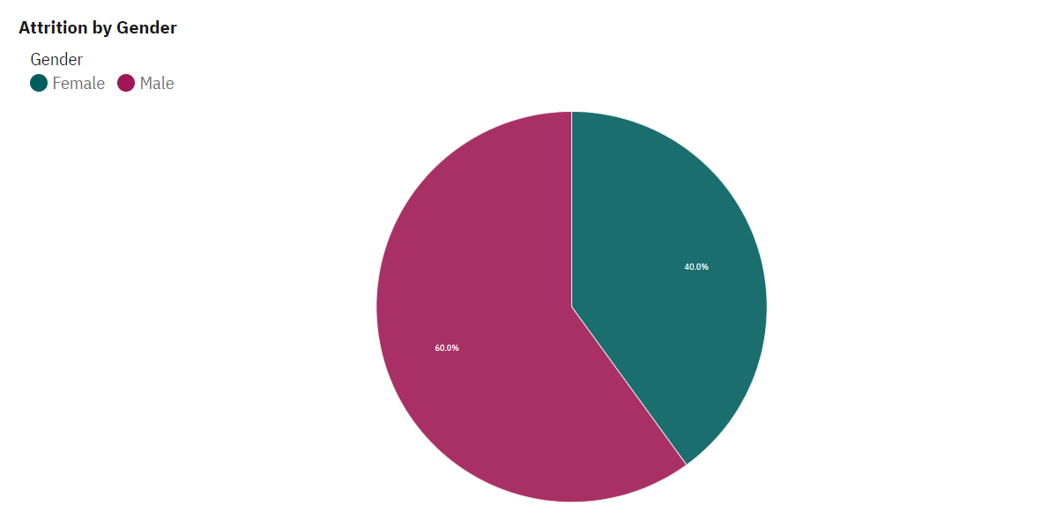
Variance in attrition rate across different factors

Slide 13
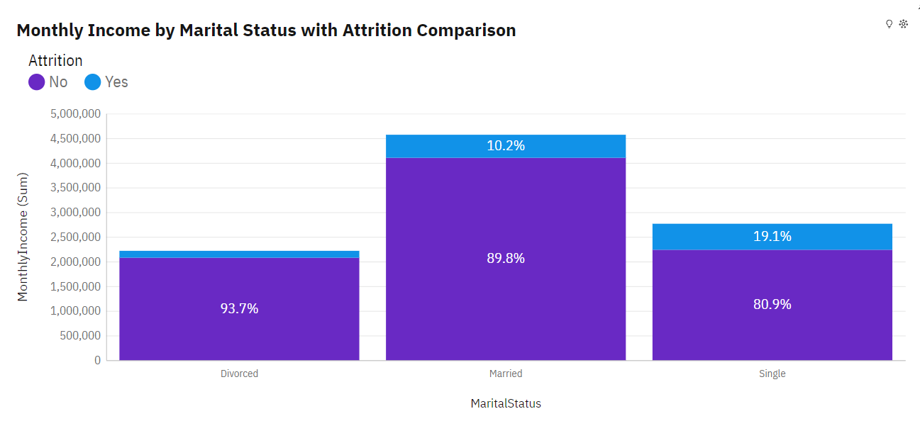
Variance in attrition rate across different factors

Slide 14
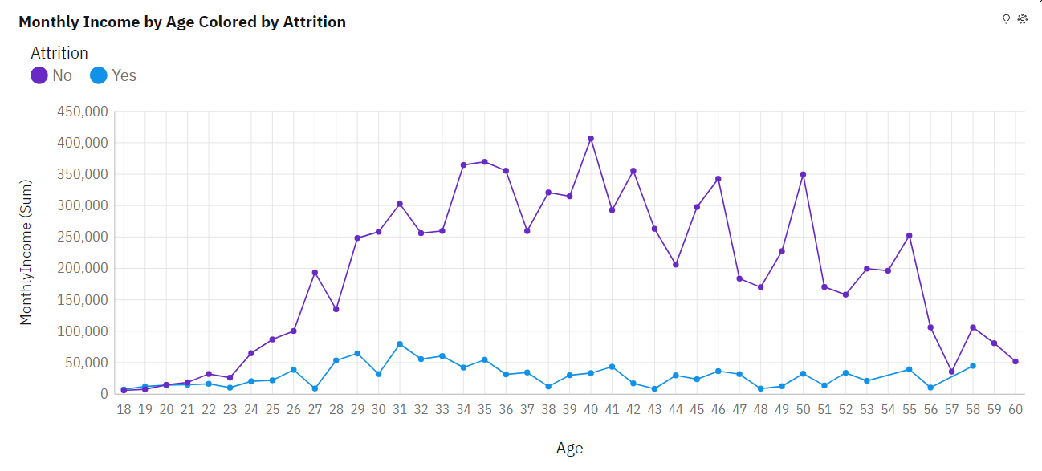
Variance in attrition rate across different factors

Slide 15
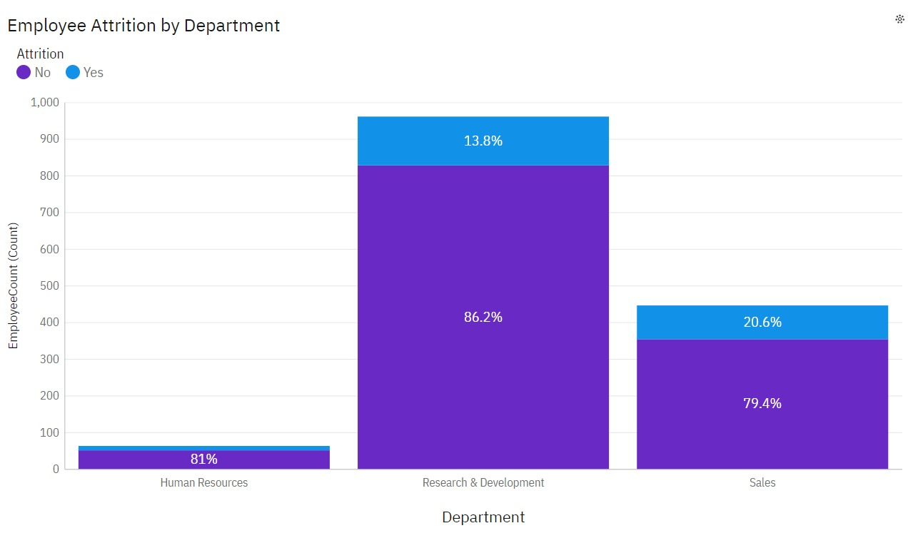
Variance in attrition rate across different factors

Slide 16
a
CONCLUSION
Moving forward, we recommend implementing targeted retention strategies based on our findings, such as enhancing employee engagement, providing professional development opportunities, and addressing department-specific issues. By doing so, we can foster a more supportive work environment that encourages long-term commitment and loyalty.

Slide 17

THANK YOU

Slide 18
a
REFERENCES
https://www.kaggle.com/datasets/pavansubhasht/ibm-hr-analytics-attrition-dataset
https://www.kaggle.com/code/faressayah/ibm-hr-analytics-employee-attrition-performance

